Slide 2
Dalton

Slide 3
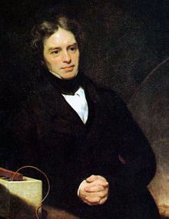
Arrhenius and Faraday
Faraday invented an early form of what was to become the Bunsen burner
introduction of spectrum analysis
discovering the laws of electrolysis, and for popularizing terminology such as anode, cathode, electrode, and ion, terms proposed in large part by William Whewell
Michael Faraday, 1842

Slide 4
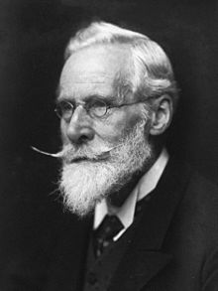
Crookes
cathode-ray studies, fundamental in the development of atomic physics
discovery was that of the element thallium, announced in 1861
He developed the Crookes tubes investigating cathode rays. He published numerous papers on spectroscopy and conducted research on a variety of minor subjects. In his investigations of the conduction of electricity in low pressure gases, he discovered that as the pressure was lowered, the negative electrode (cathode) appeared to emit rays (the so-called "cathode rays", now known to be a stream of free electrons, and used in cathode ray display devices)
Sir William Crookes in 1906

Slide 5
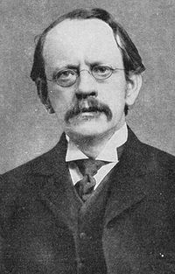
J.J. Thomson
showed that cathode rays were composed of previously unknown negatively charged particles, which he calculated must have bodies much smaller than atoms and a very large value for their charge-to-mass ratio.
Thus he is credited with the discovery and identification of the electron; and with the discovery of the first subatomic particle.
Thomson is also credited with finding the first evidence for isotopes of a stable (non-radioactive) element in 1913, as part of his exploration into the composition of canal rays (positive ions).
His experiments to determine the nature of positively charged particles, with Francis William Aston, were the first use of mass spectrometry and led to the development of the mass spectrograph.
Thomson was awarded the 1906 Nobel Prize in Physics for the discovery of the electron and for his work on the conduction of electricity in gases
Seven of his students, and his son George Paget Thomson, also became Nobel Prize winners.

Slide 6
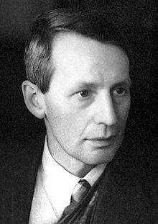
George Paget Thomson
Nobel laureate in physics recognised for his discovery with Clinton Davisson of the wave properties of the electron by electron diffraction.

Slide 7
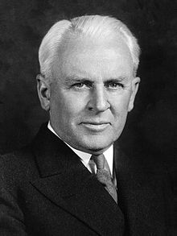
Millikan
series of experiments to determine the electric charge carried by a single electron.( Oil-drop experiment)
In 1914 Millikan took up with similar skill the experimental verification of the equation introduced by Albert Einstein in 1905 to describe the photoelectric effect.
He used this same research to obtain an accurate value of Planck’s constant.

Slide 8
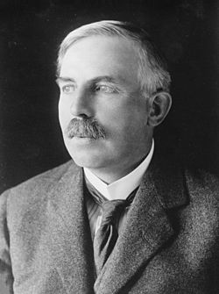
Rutherford
In early work he discovered the concept of radioactive half-life, proved that radioactivity involved the transmutation of one chemical element to another, and also differentiated and named alpha and beta radiation (McGill University in Canada) It is the basis for the Nobel Prize in Chemistry he was awarded in 1908 "for his investigations into the disintegration of the elements, and the chemistry of radioactive substances",
he and Thomas Royds proved that alpha radiation is helium nuclei.
Rutherford performed his most famous work after he became a Nobel laureate. In 1911, although he could not prove that it was positive or negative, he theorized that atoms have their charge concentrated in a very small nucleus and thereby pioneered the Rutherford model of the atom, through his discovery and interpretation of Rutherford scattering in his gold foil experiment. He is widely credited with first "splitting the atom" in 1917 in a nuclear reaction between nitrogen and alpha particles, in which he also discovered (and named) the proton
Under his leadership the neutron was discovered by James Chadwick in 1932 and in the same year the first experiment to split the nucleus in a fully controlled manner, performed by students working under his direction, John Cockcroft and Ernest Walton.

Slide 9
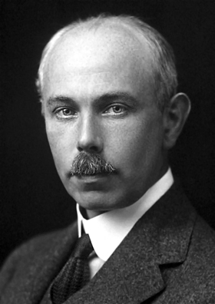
Aston
his discovery, by means of his mass spectrograph, of isotopes, in a large number of non-radioactive elements, and for his enunciation of the whole number rule

Slide 10
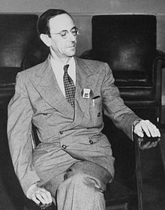
Chadwick
Using Geiger's recently developed Geiger counter, Chadwick was able to demonstrate that beta radiation produced a continuous spectrum, and not discrete lines as had been thought.
He was Rutherford's assistant director of research at the Cavendish Laboratory for over a decade at a time when it was one of the world's foremost centres for the study of physics, attracting students like John Cockcroft, Norman Feather, and Mark Oliphant.
Chadwick pursued a line of research that led to his discovery of the neutron in 1932,

Slide 11
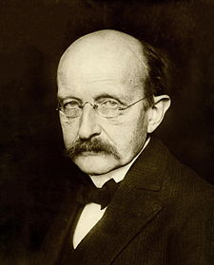
Planck
In 1894 Planck turned his attention to the problem of black-body radiation.
Planck postulate proposed that electromagnetic energy could be emitted only in quantized form, in other words, the energy could only be a multiple of an elementary unit
Among these applications and developments may be mentioned Einstein's explanation of the photoelectric effect.

Slide 12
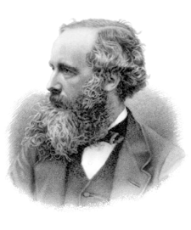
Maxwell
formulate the classical theory of electromagnetic radiation, bringing together for the first time electricity, magnetism, and light as manifestations of the same phenomenon.

Slide 13
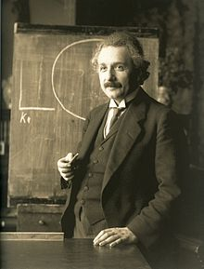
Einstein
In 1905, which has been called Einstein's annus mirabilis (miracle year), he published four ground breaking papers, on the photoelectric effect, Brownian motion, special relativity, and the equivalence of mass and energy
In a 1905 paper, Einstein postulated that light itself consists of localized particles (quanta). Einstein's light quanta were nearly universally rejected by all physicists, including Max Planck and Niels Bohr. This idea only became universally accepted in 1919, with Robert Millikan's detailed experiments on the photoelectric effect, and with the measurement of Compton scattering.

Slide 14
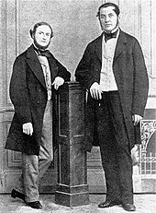
Kirchhoff and Bunsen
research on the fixed lines of the solar spectrum, and on the inversion of the bright lines in the spectra of artificial light.
He contributed greatly to the field of spectroscopy by formalizing three laws that describe the spectral composition of light emitted by incandescent objects

Slide 15
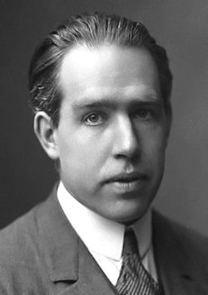
Bohr
In 1913 Bohr, by accident, stumbled across Balmer's numerology for the hydrogen spectrum, and in a flash came up with a workable model of the atom. The model asserts that:
The planetary model is correct.
When an electron is in an "allowed" orbit it does not radiate. Thus the model simply throws out classical electromagnetic theory. Technical note: an allowed orbit is one in which the electron mass times its speed times the radius of the orbit is equal to a positive integer n times Planck's constant divided by 2 pi. The integer n can be 1, 2, 3, 17, 108, etc. In fact, there are an infinite number of allowed orbits corresponding to the infinite number of positive integers.
When an electron absorbs energy from incident electromagnetic radiation, it "quantum jumps" into a higher energy allowed state. This higher energy state corresponds to an allowed orbit with a higher value of the integer n.
When an electron is in a higher energy state, it can quantum jump into a lower energy state, one with a smaller value of n, emitting all of its energy as a single photon of electromagnetic energy.

Slide 16
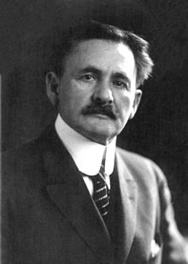
Michelson
known for his work on the measurement of the speed of light and especially for the Michelson–Morley experiment.
While at Annapolis, he conducted his first experiments of the speed of light, as part of a class demonstration in 1877. His Annapolis experiment was refined, and in 1879, he measured the speed of light in air to be 299,864 ± 51 kilometres per second, and estimated the speed of light in vacuum as 299,940 km/s,

Slide 17
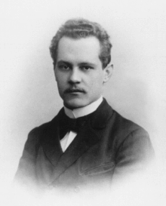
Sommerfeld
He introduced the 2nd quantum number (azimuthal quantum number) and the 4th quantum number (spin quantum number). He also introduced the fine-structure constant and pioneered X-ray wave theory.

Slide 18
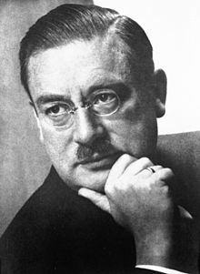
Sommerfeld and Debye
His first major scientific contribution was the application of the concept of dipole moment to the charge distribution in asymmetric molecules
In 1913, he extended Niels Bohr's theory of atomic structure, introducing elliptical orbits, a concept also introduced by Arnold Sommerfeld. In 1914–1915, Debye calculated the effect of temperature on X-ray diffraction patterns of crystalline solids

Slide 19
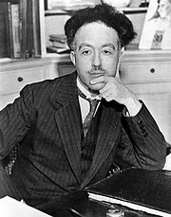
In his 1924 PhD thesis he postulated the wave nature of electrons and suggested that all matter has wave properties. This concept is known as the de Broglie hypothesis, an example of wave-particle duality, and forms a central part of the theory of quantum mechanics.

Slide 20
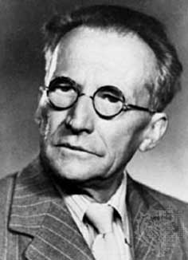
Schrödinger
Schrödinger heard of de Broglie’s electron wave, it immediately occurred to him that this idea could be used to solve the problem of electron behaviour inside an atom.
Schrödinger and others created the physics to describe electrons behaving like waves inside an atom. Schrödinger’s proposed wave mechanics was firmly based on the existing quantum concepts, and for this reason is usually referred to as quantum mechanics.
According to Schrödinger, the electron can only have certain (quantized) energies because of the requirement for only whole numbers of wavelengths for the electron wave.
the wave equations from quantum mechanics can be manipulated to produce a three dimensional probability distribution of the electron in an orbital specified by the quantum numbers. This is known as an electron probability density and can be represented in a variety of ways.

Slide 21
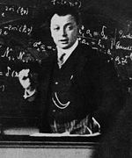
Pauli
In 1924, Pauli proposed a new quantum degree of freedom (or quantum number), with two possible values, to resolve inconsistencies between observed molecular spectra and the predictions of quantum mechanics. In particular, the spectrum of atomic hydrogen had a doublet, or pair of lines differing by a small amount, where only one line was expected. Pauli formulated his exclusion principle, stating that "There cannot exist an atom in such a quantum state that two electrons within [it] have the same set of quantum numbers."

Slide 23
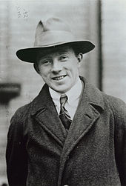
Heisenberg
Heisenberg's uncertainty principle,
quantum mechanics shows that certain pairs of physical properties, like position and speed, cannot both be known to arbitrary precision: the more precisely one property is known, the less precisely the other can be known. This statement is known as the uncertainty principle.
The uncertainty principle isn't a statement about the accuracy of our measuring equipment, but about the nature of the system itself the uncertainty principle is inherent in the properties of all wave-like systems
Heisenberg gave, as an illustration, the measurement of the position and momentum of an electron using a photon of light. In measuring the electron's position, the higher the frequency of the photon, the more accurate is the measurement of the position of the impact, but the greater is the disturbance of the electron, which absorbs a random amount of energy, rendering the measurement obtained of its momentum increasingly uncertain (momentum is velocity multiplied by mass), for one is necessarily measuring its post-impact disturbed momentum from the collision products and not its original momentum. With a photon of lower frequency, the disturbance (and hence uncertainty) in the momentum is less, but so is the accuracy of the measurement of the position of the impact

